Slide 1
GENERATIVE AI
WEEK-5
Asst.Prof.Dr.Murat ŞİMŞEK

Slide 2
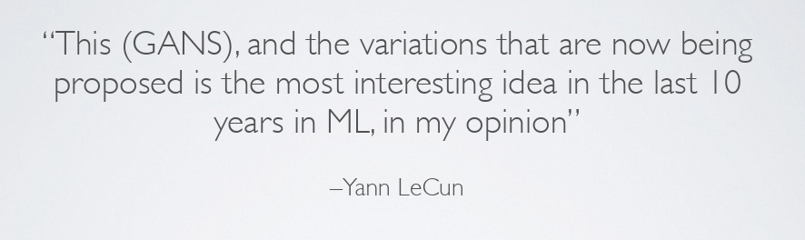
Generative Adversarial Network (GANs)

Slide 3
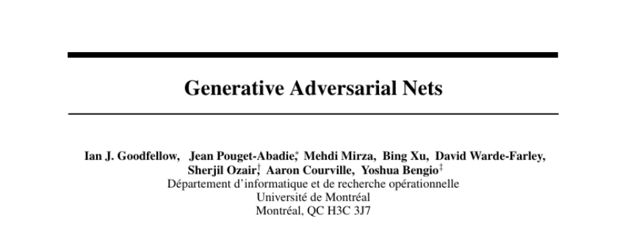
Generative Adversarial Network (GANs)

Slide 4
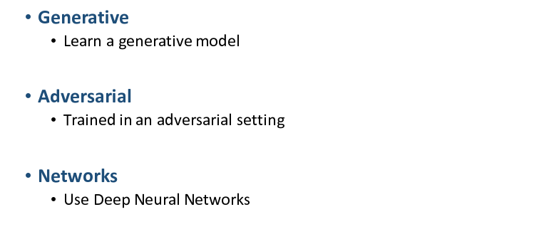
Generative Adversarial Network (GANs)

Slide 5
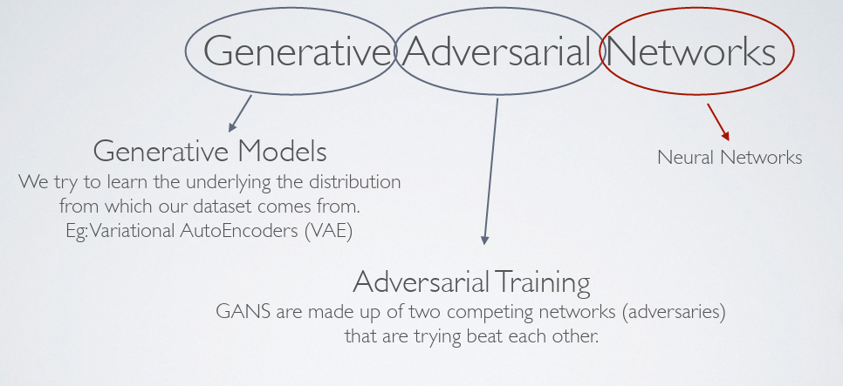
Generative Adversarial Network (GANs)

Slide 6
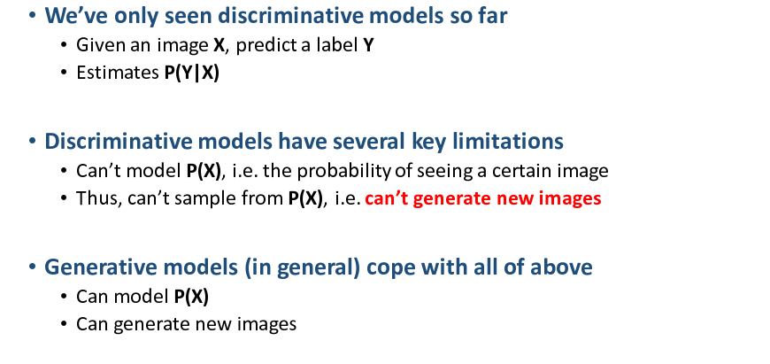
Generative Adversarial Network (GANs)

Slide 7
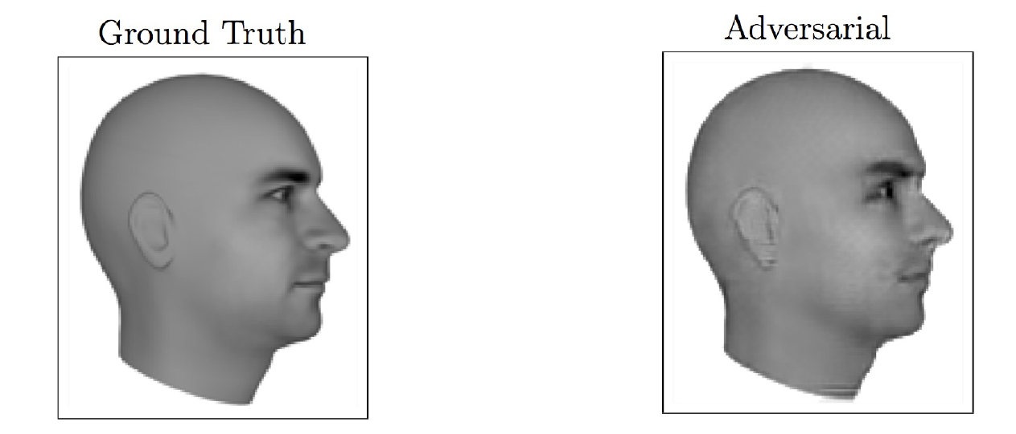
Generative Adversarial Network (GANs)

Slide 8
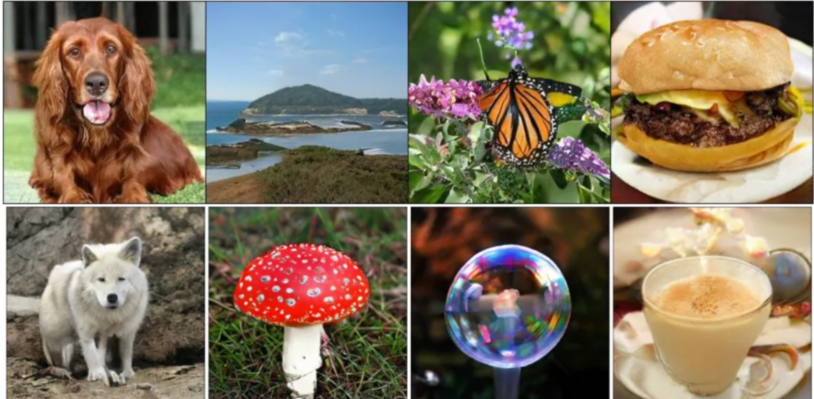
Generative Adversarial Network (GANs)

Slide 9
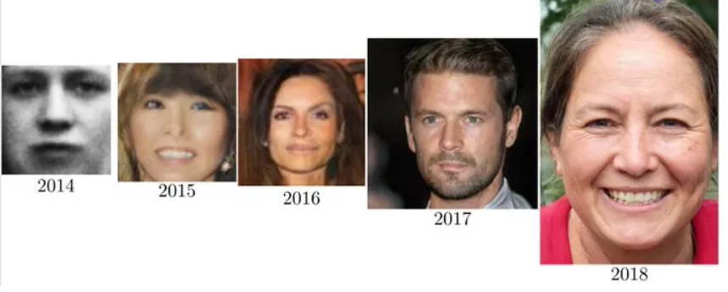
Generative Adversarial Network (GANs)
A photo showing the development of GAN

Slide 10
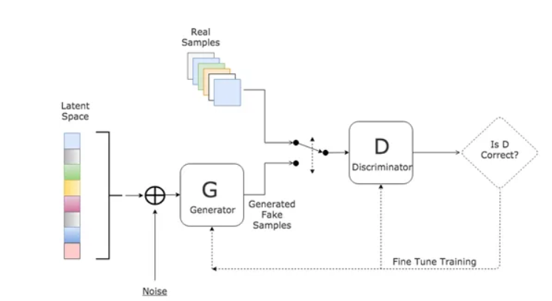
Generative Adversarial Network (GANs)

Slide 11
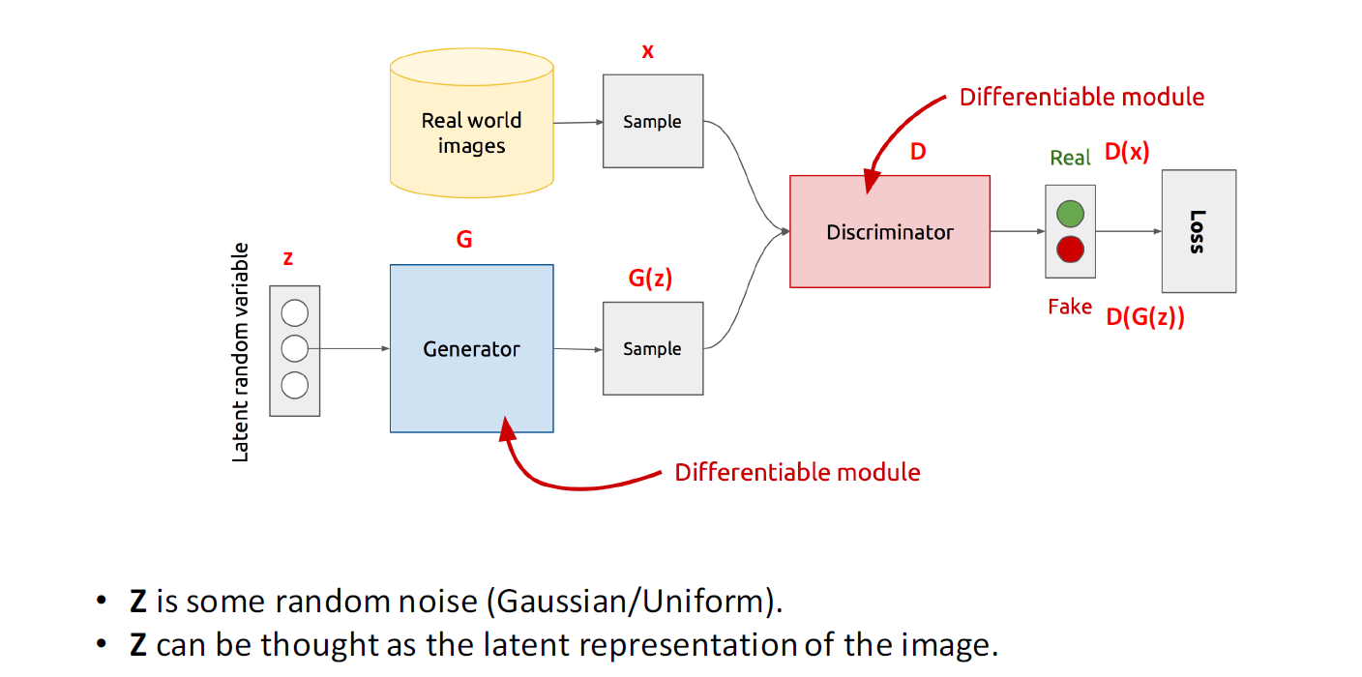
GAN’s Architecture
Notes:
Bu diyagramda Generative Adversarial Network (GAN) (Üretici Rekabetçi Ağ) temelde iki ana bileşenden oluşur:
Generator (Üretici):
Z: Rastgele bir gürültü (Gaussian/Uniform) değerini temsil eder ve bu, ağın öğrenmeye başladığı gizli (latent) değişkendir.
G(z): Bu, Z'yi alıp gerçek dünya görüntüsüne benzer yapay görüntüler üretmek için kullanan Generator'ün çıktısıdır.
Discriminator (Ayrımcı):
Gerçek veriler (x) ve üretilmiş sahte veriler (G(z)) arasında farkı ayırt etmeye çalışır.
D(x) ve D(G(z)): Ayrımcı, x (gerçek veriler) ve G(z) (sahte veriler) için bir değer döndürür. Bu değer, gerçek mi yoksa sahte mi olduğuna dair bir ihtimaldir.
Loss (Kaybı): Ayrımcı, sahte görüntüleri tanımlamaya çalışırken kayıplarını hesaplar ve bu kayıp, modelin öğrenme sürecine yön verir.
Özetle:
GAN, Generator'ün gerçekçi veriler üretmesini sağlamak için, Discriminator'ün bu verilerin sahte olduğunu anlamasını engellemeye çalışır. Bu iki ağ, birbirine karşı yarışarak daha iyi sonuçlar üretir.
This diagram represents a Generative Adversarial Network (GAN), which consists of two main components:
Generator:
Z: This represents random noise (Gaussian/Uniform) and serves as the latent variable from which the generator begins to learn.
G(z): This is the output of the Generator, which takes Z and produces synthetic images that resemble real-world images.
Discriminator:
It tries to differentiate between real data (x) and generated fake data (G(z)).
D(x) and D(G(z)): The discriminator outputs a value that indicates whether the data is real or fake.
Loss: The discriminator calculates loss values while trying to identify fake images, which guides the learning process.
In summary:
In a GAN, the Generator tries to produce realistic data, while the Discriminator attempts to distinguish between real and fake data. These two networks compete with each other, resulting in better performance over time.

Slide 12
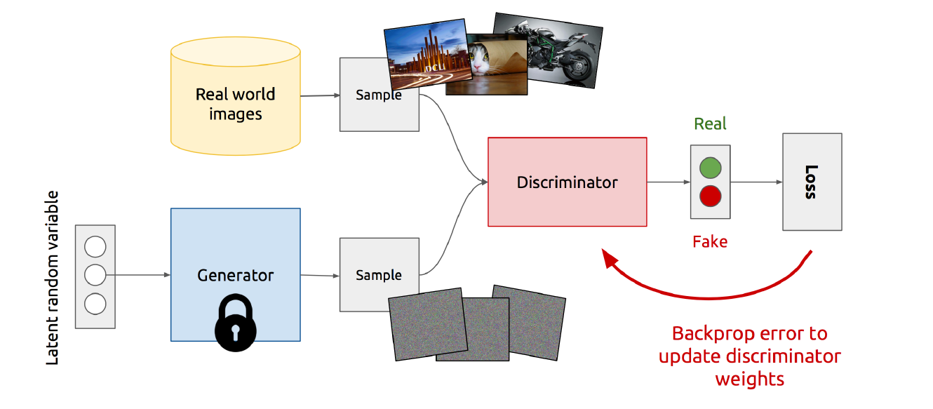
Training Discriminator

Slide 13
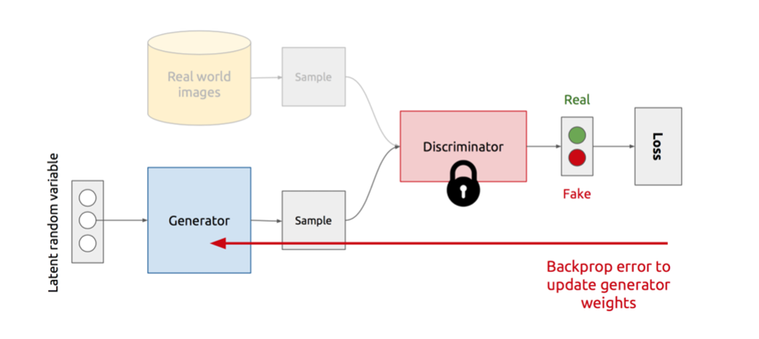
Training Generator

Slide 14
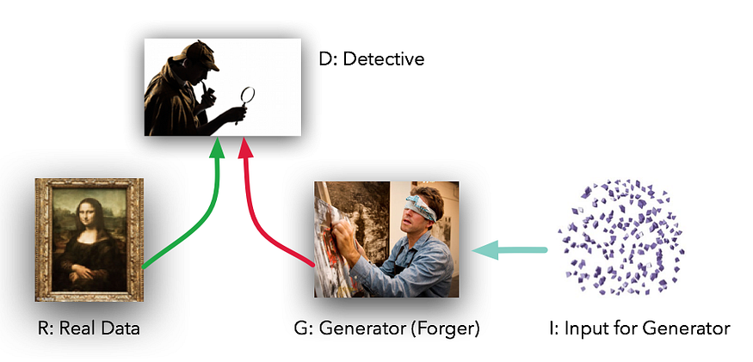
Generative Adversarial Network (GANs)

Slide 15
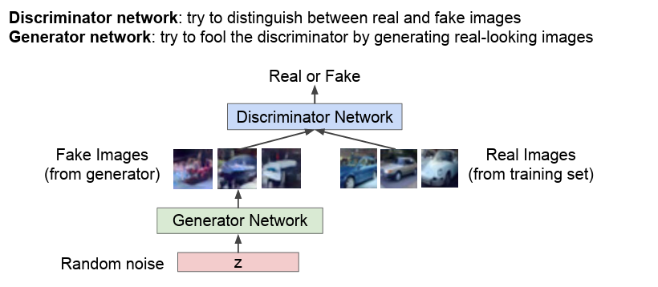
Generative Adversarial Network (GANs)

Slide 16
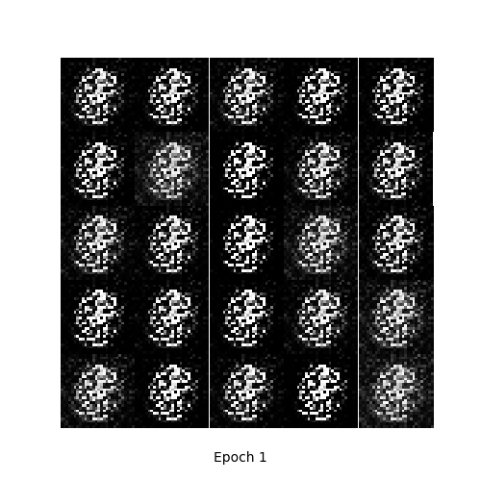
Generative Adversarial Network (GANs)

Slide 17
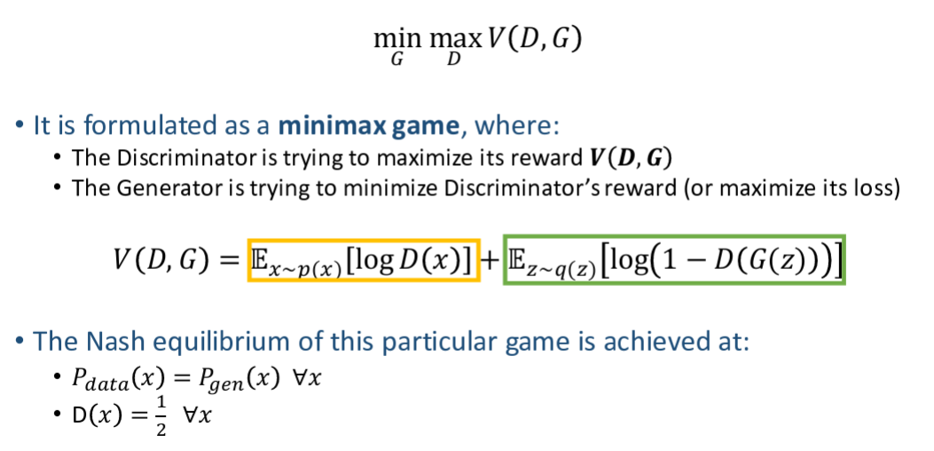
GAN’s formulation

Slide 18
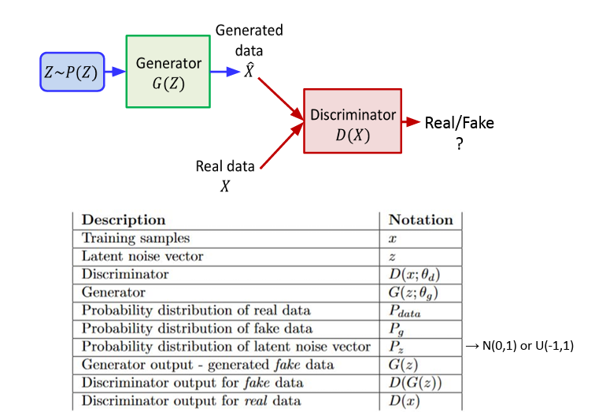
GAN’s formulation

Slide 19
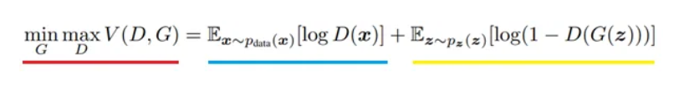
GAN’s formulation
min max V(D, G):
min max represents the minimization-maximization process where the Generator (G) tries to minimize the loss, while the Discriminator (D) tries to maximize its own objective.
V(D, G) is the overall value function that is minimized for the Generator and maximized for the Discriminator.

Slide 20
GAN’s formulation
E_x ~ p_data(x) [log D(x)] :
E stands for Expectation, or the expected value over a distribution.
x ~ p_data(x) represents that x (the real data) is drawn from the real data distribution (p_data(x)).
D(x) is the output of the Discriminator when given a real image x. The goal of the Discriminator is to maximize log D(x) for real images, meaning it wants to output a high probability that x is real.
log D(x) is the log-probability of the Discriminator classifying x as real. The Discriminator wants this term to be as high as possible for real images.

Slide 21
GAN’s formulation
E_z ~ p_z(z) [log(1 - D(G(z)))] z ~ p_z(z) means z (the latent random variable) is sampled from a prior distribution (p_z(z)), typically Gaussian or Uniform.
G(z) is the output of the Generator when given latent variable z as input, which is a generated (fake) image.
D(G(z)) is the output of the Discriminator when given the fake image generated by the Generator. The Discriminator tries to classify this fake image as fake.
log(1 - D(G(z))) is the log-probability that the Discriminator classifies the generated image as fake. The Generator tries to minimize this term by producing images that are as realistic as possible to confuse the Discriminator.
E_z is the expectation over the latent variable z. The Generator aims to minimize this term by learning to produce better fake images.

Slide 22
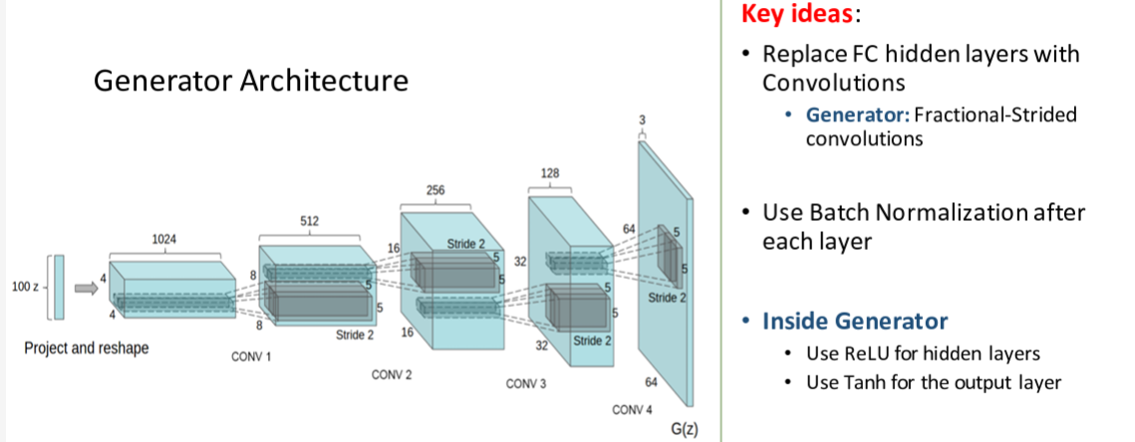
Deep Convolutional GANs (DCGANs)

Slide 23
Types of GANs
VanillaGAN
DCGAN
InfoGAN
DiscoGAN
WassersteinGAN

Slide 24
Types of GANs
VanillaGAN
DCGAN
InfoGAN
DiscoGAN

Slide 25
Vanilla GAN
Vanilla GAN is the simplest and first version of the Generative Adversarial Network.
This model consists of two main components: Generator and Discriminator.
The Generator generates new data (usually images) from random noise (latent space). The Discriminator tries to distinguish whether the data is real or fake.
Training Process: Both networks play a game against each other. The Generator tries to deceive the Discriminator, while the Discriminator tries to distinguish real data from fake data.
Limitations: Vanilla GAN often faces issues like overfitting and unstable training.

Slide 26
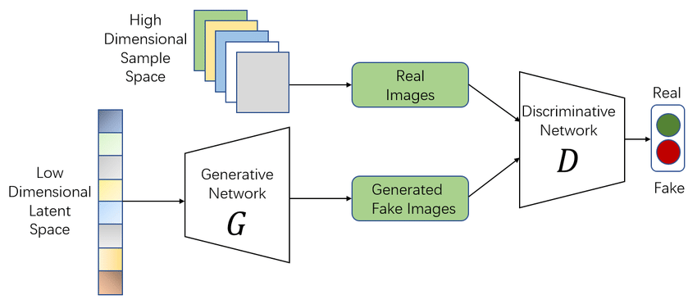
Vanilla GAN

Slide 27
Deep Convolutional GANs (DCGANs)
DCGAN is an extension of Vanilla GAN that uses deep convolutional layers to more effectively learn visual data.
Convolutional Layers: DCGAN is specifically designed for image generation and uses convolutional neural networks (CNNs) to extract deeper features, allowing for better learning of visual information and generating more realistic images.
Advantages: It provides higher accuracy and stability for visual data. It also works well with large datasets.
Training: It still follows the same min-max approach, but convolutional networks make the training process more efficient

Slide 28
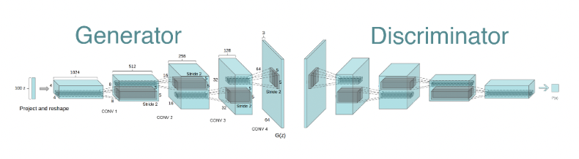
Deep Convolutional GANs (DCGANs)

Slide 29
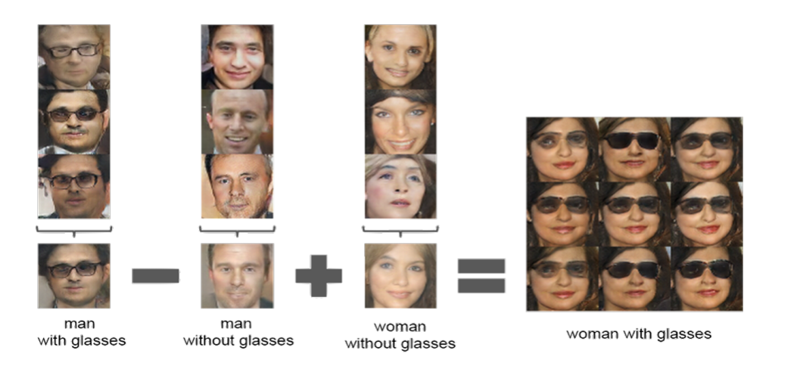
Deep Convolutional GANs (DCGANs)

Slide 30
InfoGAN
InfoGAN is a variant of GAN designed to maximize the information learned by the model. It enriches the generator with label information, providing more control over the generated outputs.
Latent Variables (Z): InfoGAN uses additional latent variables to allow the Generator to learn more meaningful and interpretable features. This enables more controlled generation of images.
Features: InfoGAN performs unsupervised learning while also allowing for the generation of labeled, interpretable features.

Slide 31
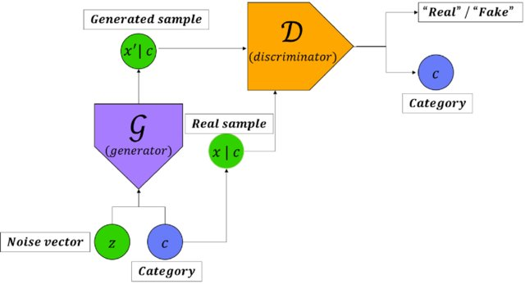
InfoGAN

Slide 32
DiscoGAN
DiscoGAN is a GAN variant designed to discover relationships between two different datasets. It is primarily used for transforming the features of one dataset into another.
Bidirectional Transformation: DiscoGAN can learn transformations between two different datasets, such as converting images from one domain to another.
Applications: It is highly useful in fields like fashion, style transfer, and image-to-image transformation.
Training: It learns the reciprocal transformation between two datasets by connecting Generator networks for each domain.

Slide 33
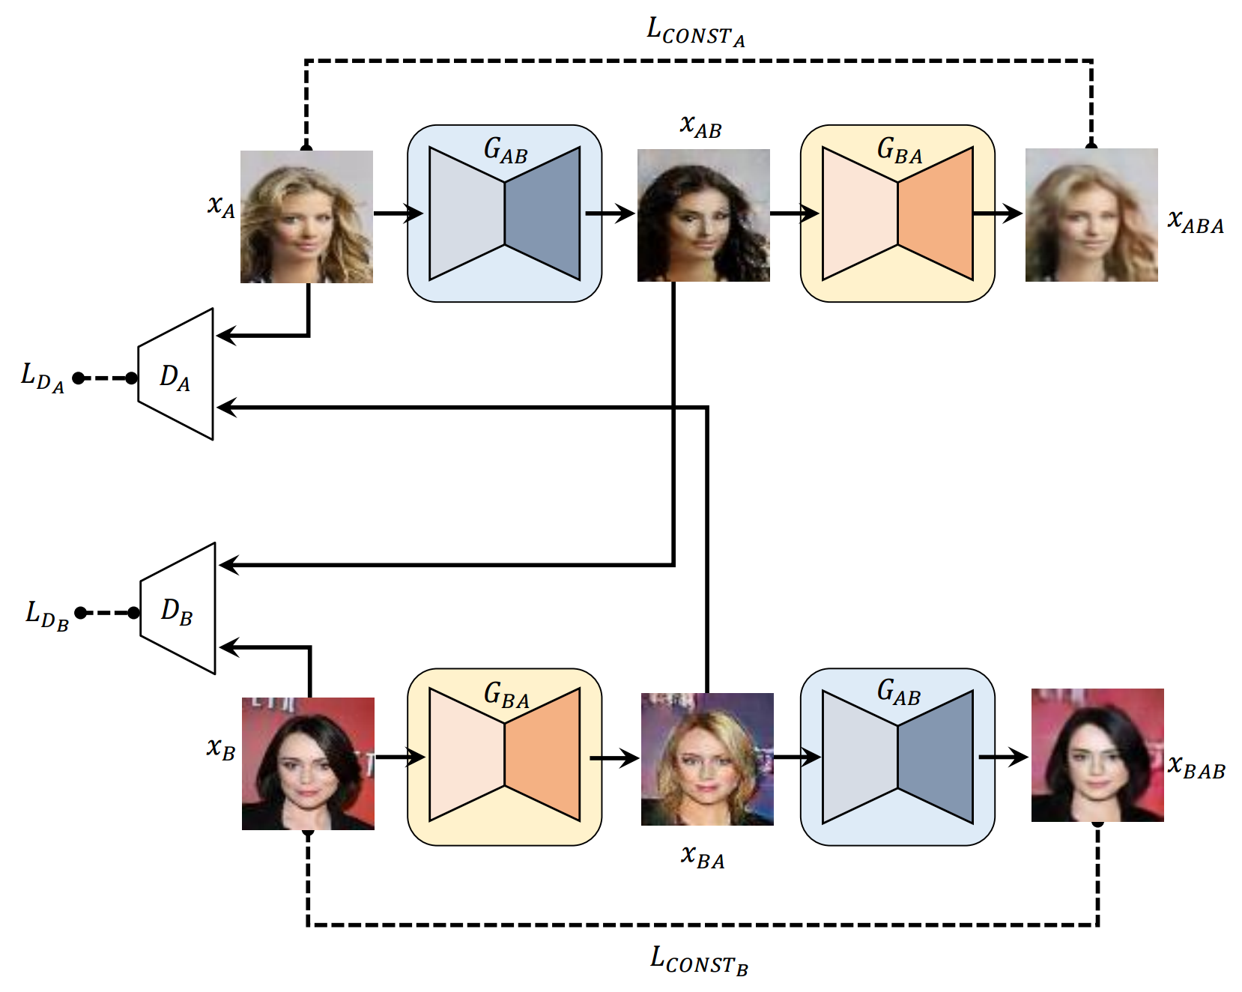
DiscoGAN

